Slide 1
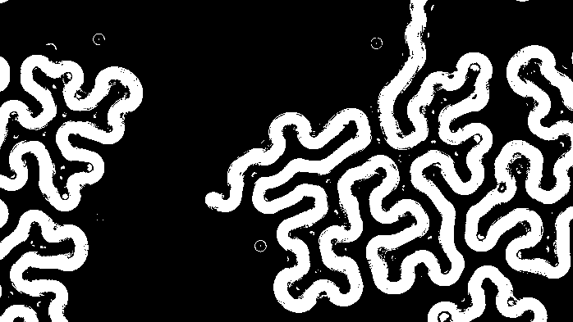
Cytomachia
Interactive web-application for exploring complex, configurable antagonistic models for cellular automata

Slide 2
Team
Sean Butterfield buttersn@mail.uc.edu
Lead developer, designer
Project Advisor
Dr. Badri Vellambi badri.vellambi@uc.edu

Slide 3
Cellular Automata Overview
Simple rules, complex behaviors
Grid of cells that ‘evolve’ over discrete timesteps based on local conditions
Each cell has a state: Alive, or Dead
Local conditions determine if a cell: stays alive, dies, or is born each timestep
Conway’s Game of life

Slide 4
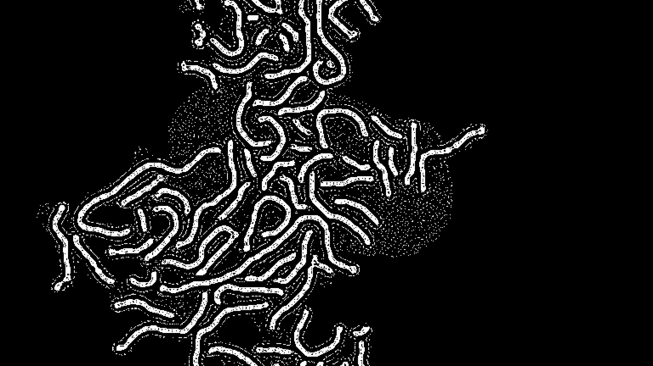

Slide 5
Project Abstract
This Project will be focused around an interactive application designed to explore multiple neighborhood cellular automata and competition of cellular automata rules in a configurable environment. The application is planned to be designed to allow for configurable rule sets, with the ability to add and configure multiple competing rulesets, as well as neighborhood shapes and sizes. The aim is to be able to use this application to explore the field of cellular automata as it relates to both the simulation of ecological competition and artistic merit of discovering new and interesting configurations and emergent patterns.

Slide 6
User Stories
As someone interested in cellular automata, I would like an application to visually see the results of changing rulesets in cellular automata
As someone interested in cellular automata, I would like to understand how neighborhood shapes and sizes affect the ending simulation
As someone interested in cellular automata, I would like an application that allows me to configure competing rulesets in cellular automata
As someone interested in 2D simulations, I would like an easy-to-use web-application to see what kind of cool looking patterns I can create using cellular automata

Slide 7
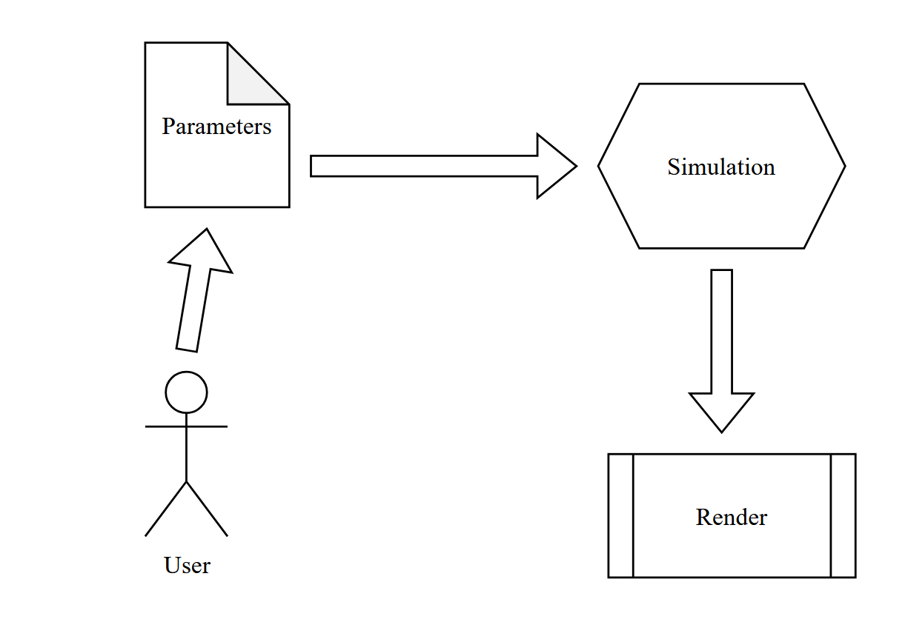
Design Diagram level 0

Slide 8
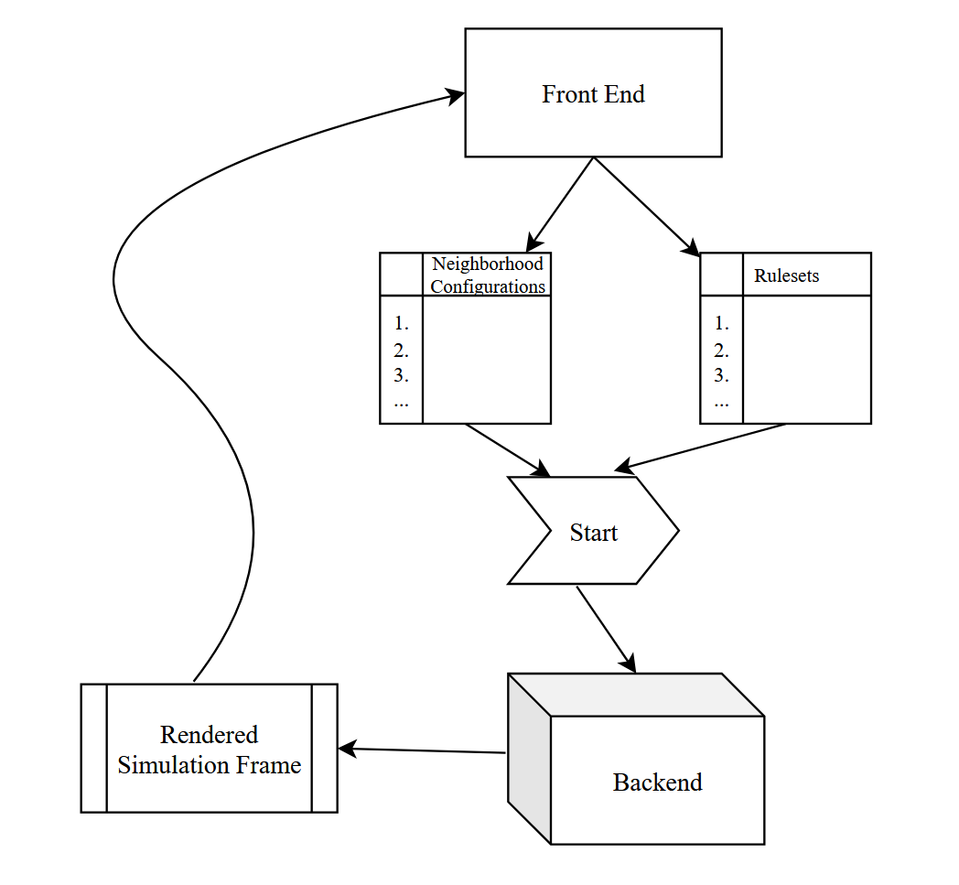
Design Diagram level 1
sGPU

Slide 9
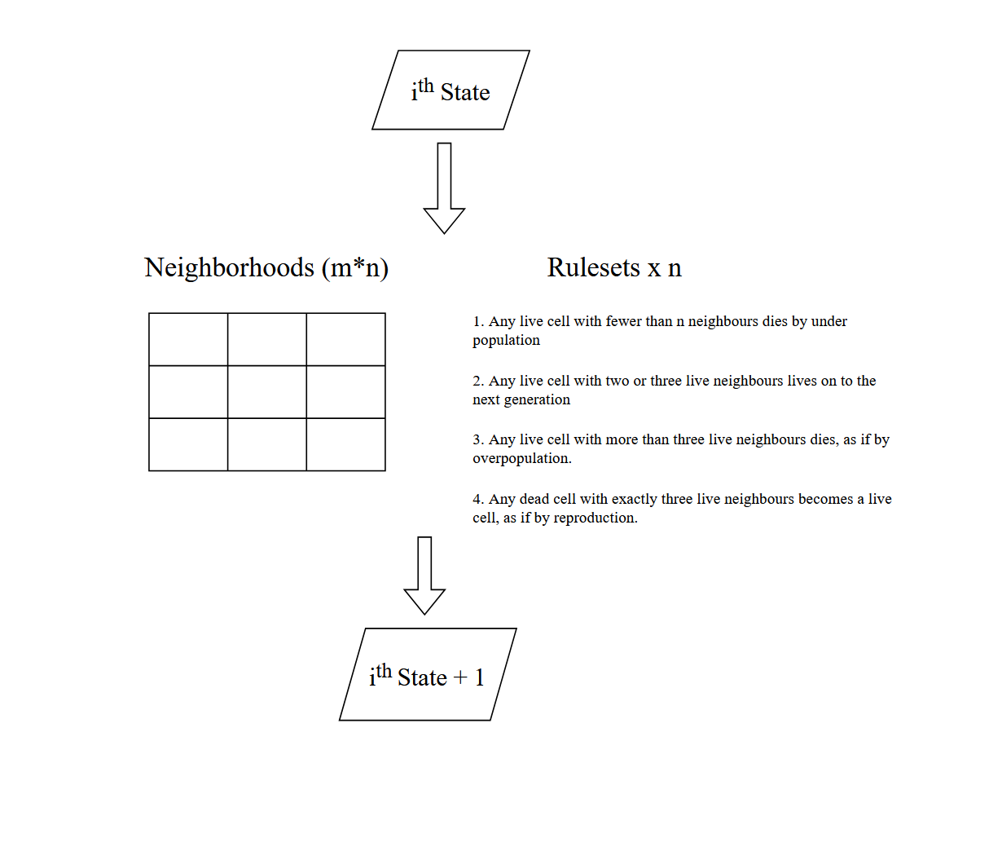
Design Diagram level 2

Slide 10
Design Constraints
Scope: As the sole developer of this project the total project scope will be limited to the work I am able to complete
Economic: The aim is to have a near-zero cost project, utilizing open-source packages and using client-side rendering to save on cloud computing costs.
Computational: The total resolution, size/number of neighborhoods, and number of rulesets will increase computation, so in order for simulations to look good in real-time, GPU processing will be utilized for computation.
Accessibility: Easy-to-use and intuitive interface, color-safe pallets

Slide 11
Current Progress
Project constraints, design diagram, task list, effort matrix
Repo with project information
Angular web-app simulating basic cellular automata. (non-configurable)

Slide 12
End of Term goals
GPU based simulation
UI and implementation for custom ruleset configuration
UI and implementation for customizable neighborhoods

Slide 13
Goals for expo
Fully functional web-app
Fast and responsive simulation
Easy to configure rulesets and neighborhoods
Allow for multiple competing rulesets
Customizable color pallet and accessibility options

